Slide 1
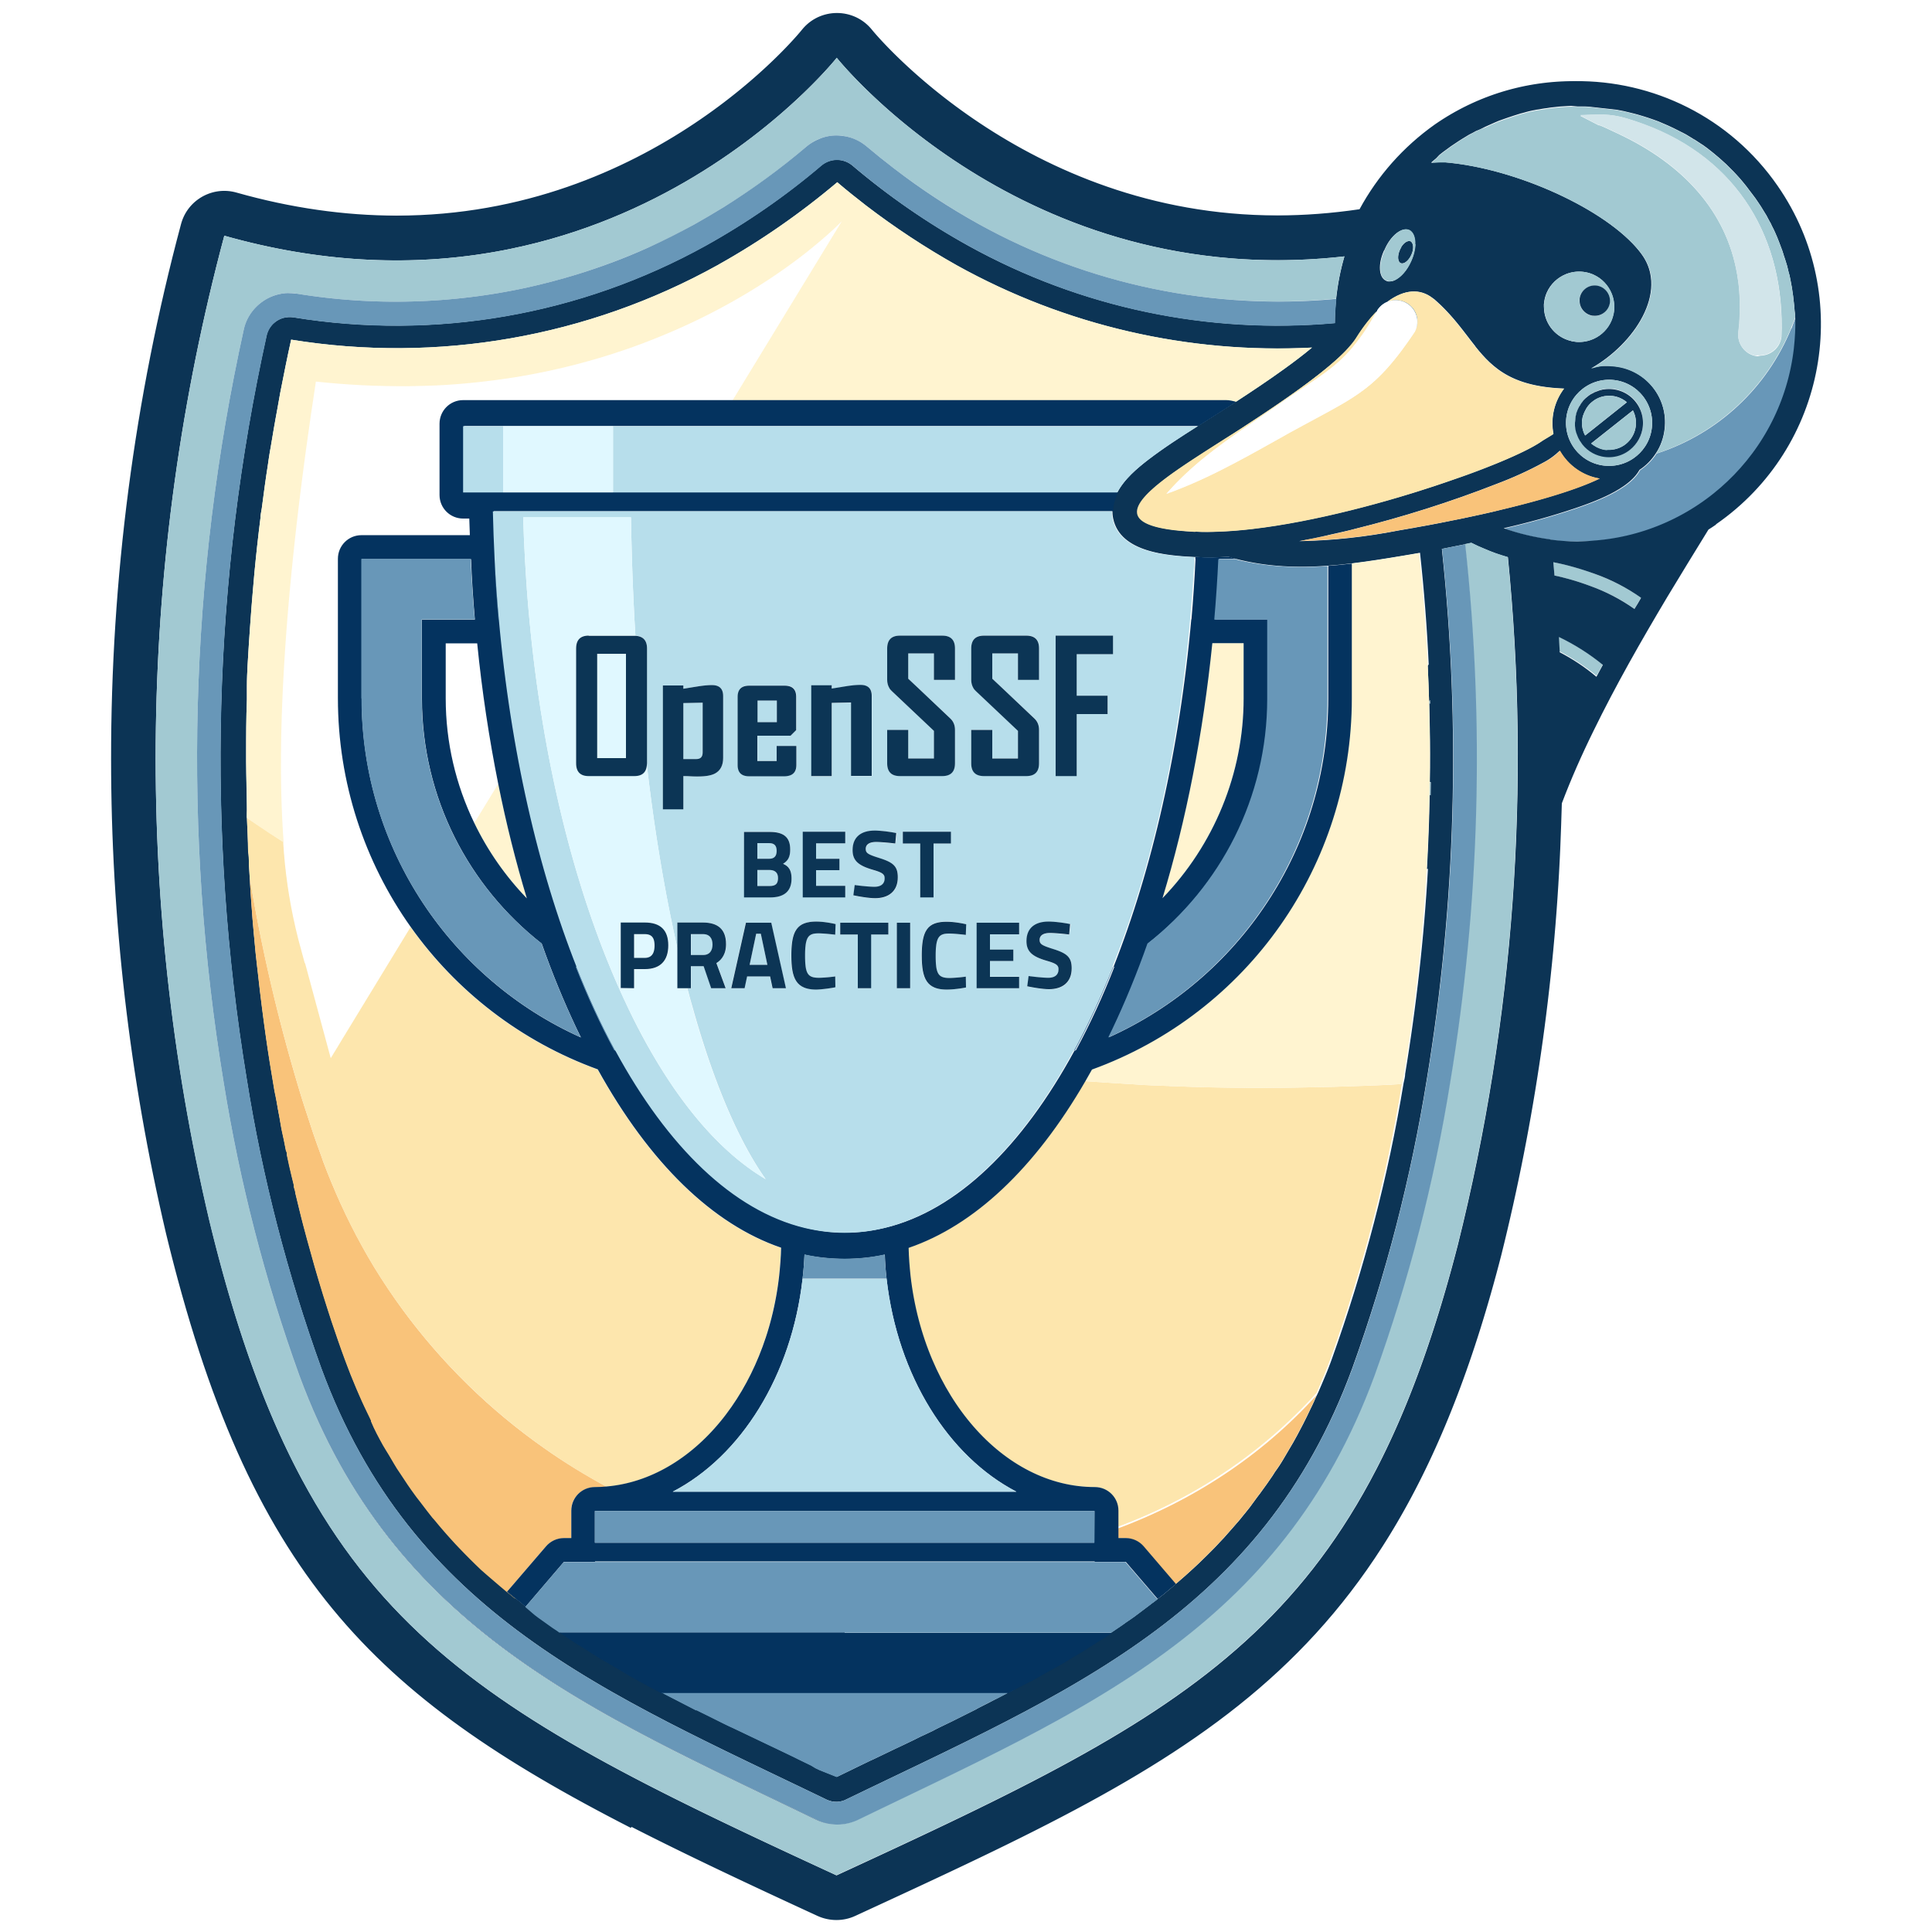
An Introduction to the Open Source Security Foundation (OpenSSF) Best Practices Badge
David A. Wheeler, dwheeler AT linuxfoundation DOT org
Director of Open Source Supply Chain Security
Linux Foundation
2023-11-28
Note: This was formerly known as the
Core Infrastructure Initiative (CII) Best Practices Badge
Notes:
Hi, my name’s David A. Wheeler.
This presentation is an introduction to the Core Infrastructure Initiative (CII) Best Practices Badge. I hope to convince you that if you are part of an open source software project, you should try to get a best practices badge to help you identify and follow best practices. I also hope to convince you that if you use open source software, you should look for and prefer software that is following best practices, and that the badge can help you identify such projects. To get there, this presentation will explain the basics of the CII best practices badge. We’ll first start with a little history, which I think will help why the badge exists.

Slide 2
Antitrust Policy Notice
Linux Foundation meetings involve participation by industry competitors, and it is the intention of the Linux Foundation to conduct all of its activities in accordance with applicable antitrust and competition laws. It is therefore extremely important that attendees adhere to meeting agendas, and be aware of, and not participate in, any activities that are prohibited under applicable US state, federal or foreign antitrust and competition laws.
Examples of types of actions that are prohibited at Linux Foundation meetings and in connection with Linux Foundation activities are described in the Linux Foundation Antitrust Policy available at http://www.linuxfoundation.org/antitrust-policy. If you have questions about these matters, please contact your company counsel, or if you are a member of the Linux Foundation, feel free to contact Andrew Updegrove of the firm of Gesmer Updegrove LLP, which provides legal counsel to the Linux Foundation.
See: https://www.linuxfoundation.org/antitrust-policy/

Slide 3

Heartbleed
In 2014, Heartbleed vulnerability found in OpenSSL
Highlighted OSS* projects don’t always follow widely accepted practices, which results in avoidable problems
*OSS=Open source software. OSS is licensed to its users in a way that allows them to run the program for any purpose, study and modify the program, and freely redistribute copies of either the original or modified program (without royalties to original author, etc.)
Notes:
In 2014, the Heartbleed vulnerability was found in the OpenSSL cryptographic library. OpenSSL is widely used, so this vulnerability had a big impact. However, the bigger issue was that when people investigated the OpenSSL project itself, many didn’t like what they saw. At the time the OpenSSL project didn’t have a lot of support and failed to apply some widely accepted practices. Defects, including vulnerabilities, can happen to any project, but avoidable problems are something else.
==
Heartbleed logo is free to use, rights waived via CC0, per http://heartbleed.com/

Slide 4
OSS project practices matter!
It is not true that “all OSS is insecure” … or that “all OSS is secure”
It is not true that “all OSS is poor quality” … or that “all OSS has excellent quality”
OSS has potential advantage (mass peer review)
OSS tends to be more secure & higher quality if the project follows good practices
Good people necessary, but insufficient
Both creators & users of OSS want good results
What are those good practices?
How can we encourage projects to follow them?
How can anyone know if they’re being followed?
Notes:
In short, the practices used by an OSS project affect its users. It is NOT true that all OSS is insecure, or that all OSS is secure. Similarly, it is NOT true that all OSS is of poor quality, or that it all has excellent quality. Instead, OSS tends to be more secure and higher quality if the project follows good practices.
Practices aren’t enough, of course, because OSS projects need good people to develop the software. But good people aren’t enough. If the project doesn’t test the software that the project develops, or doesn’t use version control software, or doesn’t follow other widely accepted good practices, then many avoidable problems typically result. Both creators and users of open source software want good results, so it’d be helpful to encourage identifying those practices and encouraging their use. But what are those good practices? How can we encourage projects to follow them? And how can anyone know if those good practices being followed by some particular project?

Slide 5
Open Source Security Foundation (OpenSSF) Best Practices Badge
Identified best practices for OSS projects
For production of OSS**
Based on practices of well-run OSS projects
Increase likelihood of better quality & security
Criteria designed for any OSS project
Web application: OSS projects self-certify
If OSS project meets criteria, it gets a badge
No cost
Self-certification mitigated by automation, public display of answers (for criticism), spot-checks, and can be overridden if false
Former name: CII* Best Practices Badge
* CII = Core Infrastructure Initiative
** for receiving OSS, esp. license compliance, see OpenChain
Notes:
This leads us to the CII best practices badge. We identified a set of best practices for producing OSS, based on the practices of well-run OSS projects. Each practice increases the likelihood of producing better quality or security. We then turned those practices into a simple set of criteria that can be applied to any OSS project. Some criteria also apply to proprietary software, but many don’t, because many criteria focus on enabling worldwide review and participation.
We also developed a web application that allows OSS projects to self-certify that they meet the criteria. If an OSS project meets the criteria, the project gets a corresponding badge. All of this is at no cost to the OSS projects. We chose self-certification because there are literally millions of OSS projects, and self-certification can scale to such sizes. Self-certification systems can have problems, so we countered those problems in a variety of ways. Perhaps the most important is that we automate the process; in a number of cases we automatically determine if a project meets a criterion. We also require that the answers be public, so that the public can judge the accuracy of the answers. We do spot-checks, and the answers can even be overridden if a project falsifies their answers. As a result, we believe we’ve developed an approach that scales yet provides good confidence in those answers.

Slide 6
Who runs the Badging Project?
Linux Foundation (LF)
“dedicated to building sustainable ecosystems around open source projects to accelerate technology development and industry adoption”
nonprofit mutual benefit corporation, 501(c)(6)
Linux kernel, JS Foundation, Cloud Native Computing Foundation (CNCF), R Consortium, LF Energy, …
Open Source Security Foundation (OpenSSF)
“Securing the open source ecosystem”
Transitioned from CII to OpenSSF in 2020, renamed 2021
Badging project is an OSS project
Yes, we earn our own badge ☺
Notes:
The badging project was created by the Linux Foundation’s Core Infrastructure Initiative, abbreviated as CII. The Linux Foundation is a nonprofit mutual benefit corporation which already supports a wide variety of OSS projects that you probably use every day, such as the Linux kernel, JS foundation, cloud native computing foundation, and R consortium.
The badging project is itself an OSS project, and you’ll be glad to know that we earn our own badge.

Slide 7
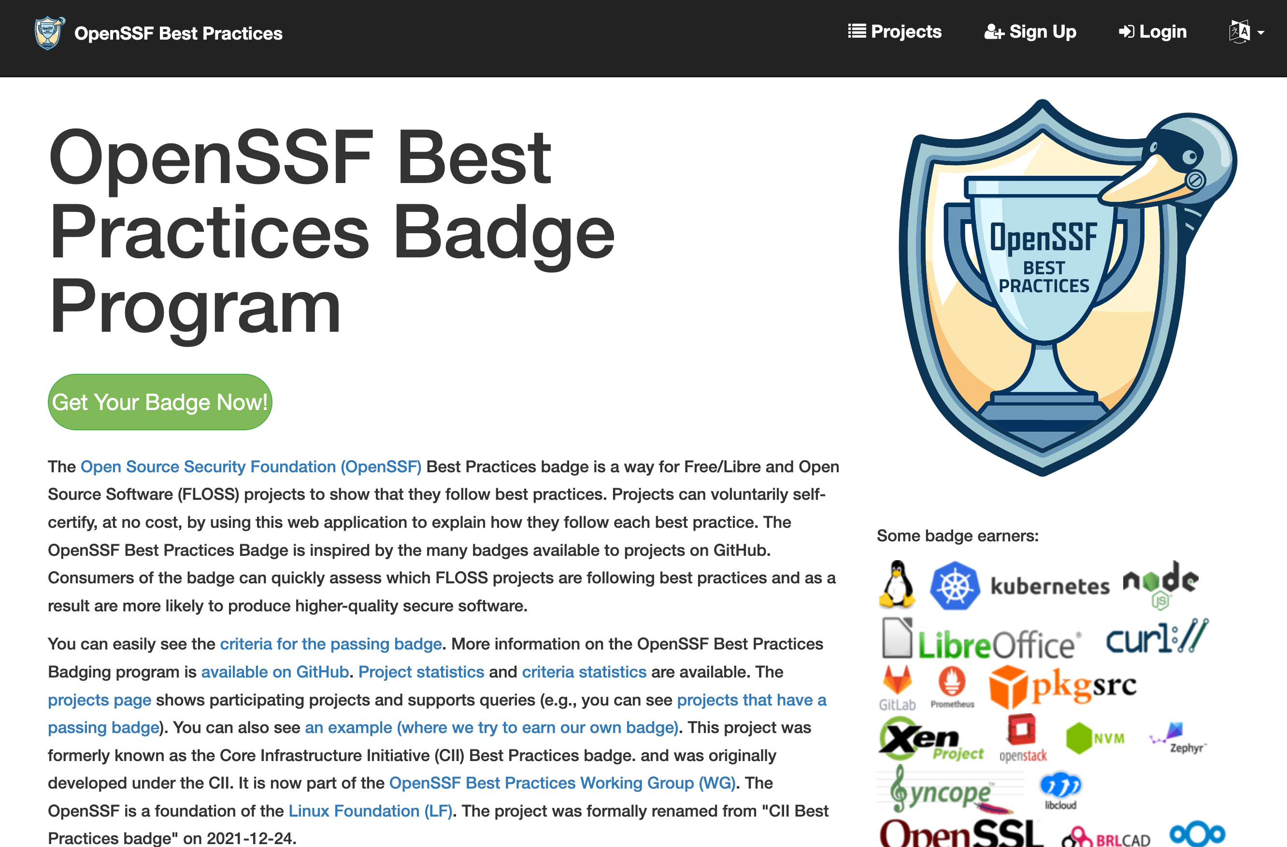
BadgeApp: Home page
To get your OSS project a badge, go to https://bestpractices.dev/
Notes:
If you can’t remember anything else from this presentation, please remember that if you participate in an OSS project, please go to https://bestpractices.coreinfrastructure.org and start the process of getting a badge. What you see here is a quick screenshot of our home page, you just click on the green button to get started. You can also click on the Projects link to see some of the other projects that have or are working on getting a badge.

Slide 8
























Some OSS projects with a best practices badge
GNU Make
Notes:
Lots of OSS projects have earned a best practices badge. You’re probably using many of them now. Badge earners include the Linux kernel, Kubernetes, Node.js, and curl. The OpenSSL project has made a number of changes, and they’ve earned a badge too.
===
Most of the logos shown here have a trademark owned by their respective project. They’re shown here to help quickly identify them (and congratulate them!).

Slide 9
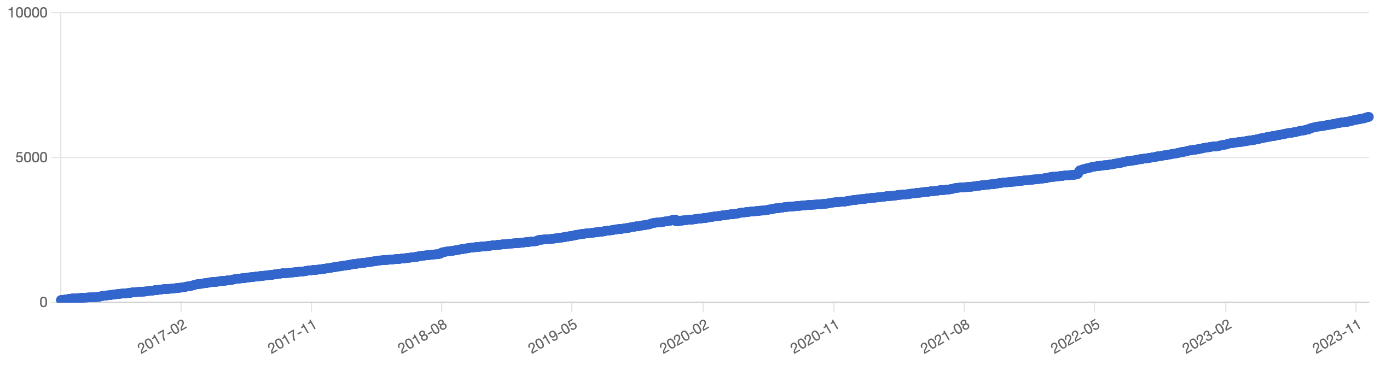
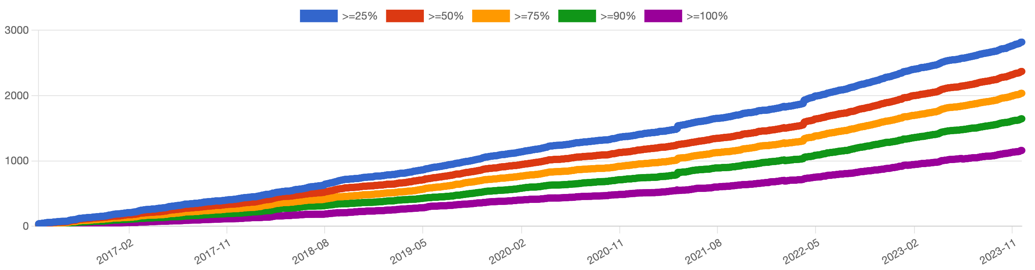
CII badges are increasingly getting adopted!
Over 6,400 projects participating!
All
projects
General availability May 2016
Projects with non-trivial progress
Over 1,100 passing!
Source: https://bestpractices.coreinfrastructure.org/project_stats as of 2023-11-28
Notes:
As you can see, since May 2016 when the CII Badging project became generally available we’ve had continuous growth in the number of participating projects and the number of projects that have earned a passing badge.

Slide 10
Badge levels
Three badge levels (passing, silver, gold)
For higher levels, must meet previous level
Passing:
Captures what well-run projects typically already do
Not “they should do X, but no one does that”
66 criteria in 6 groups:
Basics, Change Control, Reporting, Quality, Security, Analysis
Silver: Harder but possible for 1-person projects
Gold requires multiple developers
bus factor > 1*, 2-person review
Source: https://github.com/coreinfrastructure/best-practices-badge/ blob/master/doc/criteria.md
Notes:
There are three badge levels: passing, silver, and gold. “Passing” captures what well-run projects typically already do. Silver is harder but is still possible for 1-person projects. Gold is even more difficult and includes criteria that require multiple developers.

Slide 11
Badge criteria developed to be reasonable!
Relevant
Attainable by typical OSS projects (esp. passing)
Clear
Include security-related criteria (but not only those)
Consensus of developers & users
Criteria & web app developed as OSS project
Built on existing work, e.g., Karl Fogel’s Producing Open Source Software
Not hypocritical
Our web app must get its own badge!
Worked with several projects, such as the Linux kernel & curl, to test criteria validity
Notes:
It’s important to understand that these criteria were specifically developed to be reasonable. This slide briefly lists some of the questions we asked before adding any criterion. I’m not going to go into these points in detail, I just want to emphasize that we strived to create reasonable criteria. We also worked with a number of projects to develop and review the criteria, to make sure they would work in a variety of circumstances.

Slide 12
Non-requirements
Does NOT require any specific technology, product, or service
Does NOT require or forbid any particular programming language
Sometimes includes tips
Exception: Expect projects to have a web page with TLS
NEVER requires proprietary software or service
You may use or depend on it
Does NOT cost anything
Does NOT “take over your project”
Does NOT require doing everything immediately
Some projects have immediately earned a badge
Most projects try for a badge, find some things missing, & gradually work to fix those issues
Notes:
Perhaps most important is what we do not do. We do not require any particular technology, product, or service. For example, we do not require or forbid any particular programming language. We do include tips for some common circumstances, but those are simply suggestions to help people in those common circumstances. One exception is that we do expect projects to have a web page and use TLS to secure web pages, because this provides a widely-used standard and secure way to get basic information. We never require proprietary software or a proprietary service, though projects may choose to use them. Getting a badge doesn’t cost anything. We do not “take over your project” – we simply present the criteria, and your project can decide how to meet them or even if the project should meet them. Most importantly, we do not require that everything be done immediately. Some well-run projects have immediately earned a badge, but most projects find that they are missing a few things. That’s not a problem – just fill in the website form with your current state, and update it later as you resolve those issues.

Slide 13
Sample passing badge criteria (yes, they’re reasonable)
“The project website MUST succinctly describe what the software does (what problem does it solve?).” [description_good]
“The project MUST use at least one automated test suite that is publicly released as FLOSS (this test suite may be maintained as a separate FLOSS project).” [test]
“At least one static code analysis tool MUST be applied to any proposed major production release of the software before its release, if there is at least one FLOSS tool that implements this criterion in the selected language.” [static_analysis]
“The project sites (website, repository, and download URLs) MUST support HTTPS using TLS.” [sites_https]
“The project MUST publish the process for reporting vulnerabilities on the project site.” [vulnerability_report_process]
Available in English, Chinese, French, German, Japanese, & Russian
Each criterion has a unique id; each id shown here in brackets
*FLOSS=Free/Libre/Open source software
Notes:
Here are a few sample criteria. I’m just going to quickly read them to you, and hopefully you’ll agree that these are reasonable things for an OSS project to do. Note that the criteria use the term FLOSS instead of OSS, to try to include everyone who develops such software regardless of their motivations. Every criterion has a unique identifier; identifiers are shown here in square brackets.
Please let me just read them to you.
“The project website MUST succinctly describe what the software does (what problem does it solve?).” [description_good]
“The project MUST use at least one automated test suite that is publicly released as FLOSS (this test suite may be maintained as a separate FLOSS project).” [test]
“At least one static code analysis tool MUST be applied to any proposed major production release of the software before its release, if there is at least one FLOSS tool that implements this criterion in the selected language.” [static_analysis]
“The project sites (website, repository, and download URLs) MUST support HTTPS using TLS.” [sites_https]
“The project MUST publish the process for reporting vulnerabilities on the project site.” [vulnerability_report_process]
Again, I hope you’ll agree that these are reasonable things for an OSS project to do.
The text of these criteria are available in a variety of natural languages.

Slide 14
Badge scoring system
To obtain a badge, all:
MUST and MUST NOT criteria (42/66*) must be met
SHOULD (10/66*) met, OR unmet with justification
Users can see those justifications & decide if that’s enough
SUGGESTED (14/66*) considered (met or unmet)
People don’t like admitting they didn’t do something
In some cases, URL required in justification (to point to evidence; 8/66* require this)
* For the passing badge
Notes:
Of course, we had to implement a badge scoring system. To obtain a badge, all the MUST and MUST NOT criteria must be met. In addition, criteria that says SHOULD have to be met or they can be unmet if there is a justification for it. Users who review the badge answers can review those justifications and determine if they are enough. Note that MUST, MUST NOT, and SHOULD all have their usual IETF meanings.
Some criteria are merely SUGGESTED. SUGGESTED criteria are criteria where there are many reasons that they might not apply to a particular circumstance or might be excessively difficult. We have some SUGGESTED criteria because we believe that people don’t like admitting they didn’t do something if it’s obvious they should.
Some criteria specifically require URLs to point to evidence. Higher-level badges require more evidence.

Slide 15
Miscellaneous info
Badging web application has automation
Automatically examines projects on creation/edits
Fills in some info & rejects obviously incorrect
Some larger organizations require badging
Open Network Automation Platform (ONAP)
Cloud Native Computing Foundation (CNCF) graduation requirement
Supports easy display of badge info
GitHub-style badge for README
REST API & CORS for easy display of info
For details, see (ONAP) https://wiki.onap.org/display/DW/CII+Badging+Program
(CNCF graduation) https://www.cncf.io/projects/graduation-criteria/
(Dashboard example) https://landscape.cncf.io/selected=kubernetes
Notes:
Here is some miscellaneous information.
As I mentioned earlier, the badging web application automates some steps. When you create a project entry we try to automatically fill in information, and when a project entry is edited we reject information that is obviously incorrect. That makes the badging process simpler and more accurate.
Some larger organizations already require badges in some cases, including the open network automation platform and the cloud native computing foundation. This shows that at least some organizations think that the badge is worth getting.
The badge application makes it easy to display badge information, for example, projects on GitHub can easily modify their README to display their current badge status. We have a REST API and support Cross-Origin Resource Sharing, also known as CORS. The REST API and CORS to make it easy to get and display information for specialized needs, for example, to support specialized dashboards.

Slide 16
Sample improvements of CII badge process
OWASP ZAP (web app scanner)
Simon Bennetts: “[it] helped us improve ZAP quality… [it] helped us focus on [areas] that needed most improvement.”
Change: Significantly improved automated testing
CommonMark (Markdown in PHP) changes:
TLS for the website (& links from repository to it)
Publishing the process for reporting vulnerabilities
JSON for Modern C++
“I really appreciate some formalized quality assurance which even hobby projects can follow.”
Change: Added explicit mention of how to privately report errors
Change: Added a static analysis check to continuous integration script
Source: https://github.com/coreinfrastructure/best-practices-badge/wiki/Impacts
Notes:
Many projects have said that getting a CII badge has been very helpful.
The OWASP ZAP project knew that they should have automated testing, but the desire to get a badge helped them turn their aspiration into a reality. The CommonMark project implemented HTTPS for their website and published how to report vulnerabilities to their project. The library JSON for modern C++ added information on how to privately report errors and added a static analysis check to their continuous integration script. These changes weren’t difficult, and the JSON for Modern C++ project said that they appreciated that these changes could be even done by hobby projects.

Slide 17
Improvements to Home Edge project (LF Edge)
Improved documentation:
Security and Testing policy
How to Contribute Guide
Descriptions (of) External APIs
Improved the build and testing system
CI infrastructures: Github->Actions - 20 checks
Integration of external software tools for code analysis:
gofmt - 92%;
go_vet - 100%;
golint – 76%;
SonarCloud: Security Hotspots – 37 -> 0; Code Smells – 253 -> 50; Duplications – 7.8% -> 2.3%
Improved security analysis:
Integrated CodeQL Analysis, LGTM services: 17 → 0 Security Alerts
Recommended that “the main thing is to start”
Source: LF Edge Technical Advisory Council (TAC) meeting, March 10, 2021,
https://wiki.lfedge.org/pages/viewpage.action?pageId=1671298 #TechnicalAdvisoryCouncil(TAC)-PreviousTACCalls-MeetingSlidesandRecordings

Slide 18
Conclusions
Involved in an OSS project? Get a badge!
Start here: https://bestpractices.coreinfrastructure.org
Don’t need to do “everything at once” – just start!
Questions? Email or create an issue
Prefer using OSS from projects using best practices
They are trying to “do the right thing”
You want to use OSS from projects like that!
CII best practices badge helps identify those projects
Criteria need additions/refinements? Translations?
Let us know, we’re also an OSS project
More info:
https://github.com/coreinfrastructure/best-practices-badge
https://github.com/coreinfrastructure/best-practices-badge/wiki/Videos
Get or check on badges at:
https://bestpractices.coreinfrastructure.org
Notes:
Are you involved in an OSS project? If you are, I strongly encourage you to try to get a badge for your project. Simply start at the badging website, https://bestpractices.coreinfrastructure.org. Don’t wait until you’re ready, simply get started and you can see what if anything is left to do. If you have questions, send us an email or create an issue, using a link at the bottom of every webpage.
If you’re looking at using some OSS, you should prefer to use OSS from projects that are applying best practices. Such projects are trying to do the right thing, and you want to use OSS from projects like that. It can be time-consuming to evaluate projects this way, so the CII best practices badge can help you identify such projects.
We’ve done our best to create good criteria, but nothing is perfect. If you think the criteria need additions or refinements, let us know. The best practices badge project is itself an OSS project, so we’d love to hear from you. If you want additional information, the URLs shown here should help.
The bottom line is: Get or check on best practices badges for OSS on https://bestpractices.coreinfrastructure.org.
Thank you for your time.

Slide 19
Backup

Slide 20
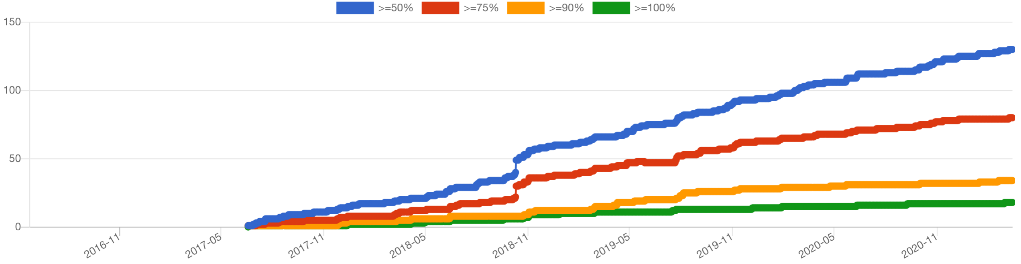
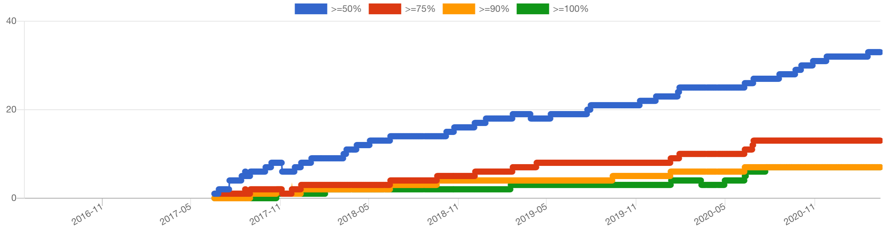
Many projects working towards silver & gold
Progress
to silver
130 projects are halfway or better,
including 18 projects with silver
Progress
to gold
33 projects are halfway or better,
including 7 projects with gold
Source: https://bestpractices.coreinfrastructure.org/project_stats?type=uncommon as of 2021-03-15

Slide 21
Some communities encouraging badges
Cloud Native Computing Foundation (CNCF)*
Maturity levels: Sandbox → incubating → graduated
For graduated level must “have achieved and maintained a CII Best Practices Badge.”
Containerd graduated, has passing badge
R community discussing recommending badges
2018 survey:
90% believe badge will provide value to the R community’s package developers or package users
77% saying it has benefit for both developers and users
74% would be willing to try it
Multiple R packages tried it out & began working towards badges as part of discussion
DBI passing
Close to passing include ggplot2, covr, dodgr, netReg
Sources: CNCF Graduation Criteria v1.2
https://github.com/cncf/toc/blob/master/process/graduation_criteria.adoc
“Should R Consortium Recommend CII Best Practices Badge for R Packages: Latest Survey Results” https://www.r-consortium.org/blog/2018/07/26/should-r-consortium-recommend-cii-best-practices-badge-for-r-packages-latest-survey-results

Slide 22
Remote access enabled
Can easily embed current badge image
<img src="https://bestpractices.coreinfrastructure. org/projects/PROJECT_NUMBER/badge">
Easily shows current state on GitHub, etc.
REST API enables easy JSON data access
Including project database download for analysis
See https://github.com/coreinfrastructure/best-practices-badge/blob/master/doc/api.md
Cross Origin Resource Sharing (CORS)
Enables data access from client-side JavaScript
E.g., for fancy client-side dashboards

Slide 23
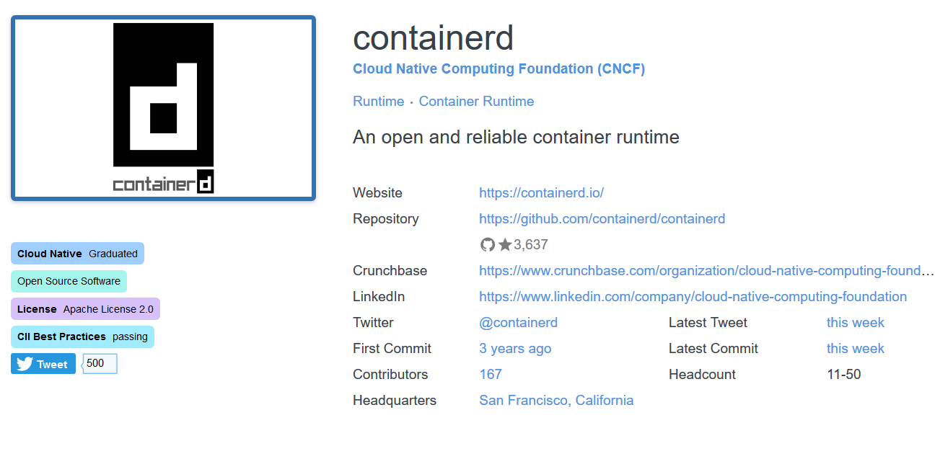
Example: CNCF landscape
CNCF landscape <https://landscape.cncf.io/> easily accesses badge data
Notes:
https://landscape.cncf.io/project=graduated&selected=containerd

Slide 24
Sample impacts of CII badge process (1 of 2)
OWASP ZAP (web app scanner)
Simon Bennetts: “[it] helped us improve ZAP quality… [it] helped us focus on [areas] that needed most improvement.”
Change: Significantly improved automated testing
CommonMark (Markdown in PHP) changes:
TLS for the website (& links from repository to it)
Publishing the process for reporting vulnerabilities
OPNFV (open network functions virtualization)
Change: Replaced no-longer-secure crypto algorithms
JSON for Modern C++
“I really appreciate some formalized quality assurance which even hobby projects can follow.”
Change: Added explicit mention how to privately report errors
Change: Added a static analysis check to continuous integration script
Source: https://github.com/coreinfrastructure/best-practices-badge/wiki/Impacts

Slide 25
Sample impacts of CII badge process (2 of 2)
BRL-CAD
Probably would have taken an hour uninterrupted, getting to 100% passing was relatively easy
Website certificate didn’t match our domain, fixed
POCO C++ Libraries
“... thank you for setting up the best practices site. It was really helpful for me in assessing the status…”
Updated the CONTRIBUTING.md file to include a statement on reporting security issues
Updated the instructions for preparing a release in the Wiki to include running clang-analyzer
Enabled HTTPS for the project website
GNU Make
HTTPS. Convinced Savannah to support HTTPS for repositories (it supported HTTPS for project home pages)
Source: https://github.com/coreinfrastructure/best-practices-badge/wiki/Impacts

Slide 26
Sample clarifications
vulnerabilities_fixed_60_days (PR #1188)
“There MUST be no unpatched vulnerabilities of medium or high severity that have been publicly known for more than 60 days.”
Added: “… this badge criterion, like other criteria, applies to the individual project. Some projects are part of larger umbrella… An individual project often cannot control the rest, but an individual project can work to release a vulnerability patch in a timely way.”
hardened_site (PR #1187)
“The project website, repository (if accessible via the web), and download site (if separate) MUST include key hardening headers… [GitHub is known to meet this]”
Added: “Static web sites with no ability to log in via the web pages may omit the CSP and X-XSS-Protection HTTP hardening headers, because in that situation those headers are less effective.”

Slide 27





Most common challenges for getting a badge
All projects 90%+ but not passing (2019-03-07)
265 projects. MUST with Unmet or “?” => Top 10 challenges:
# | Criterion | %miss | Old rank#
1 | vulnerability_report_process | 21% | 1
2 | tests_are_added | 17% | 3
3 | vulnerability_report_private | 15% | 4
4 | know_secure_design | 13% | 9
5 | vulnerabilities_fixed_60_days | 13% | 24
6 | test_policy | 13% | 5
7 | know_common_errors | 13% | 7
8 | static_analysis | 11% | 8
9 | static_analysis_fixed | 11% | 21
10 | sites_https | 9% | 2
Vulnerability reporting
Tests
HTTPS
Know secure
development
Fixing
This data is as of 2019-03-07, old rank from 2017-09-06
Analysis
Mostly same challenges as 2017-09-06. HTTPS becoming less of a problem,
dropped from #2 to #10. Unclear why fixing things has become bigger problem..!
Notes:
To determine what the “top 10” challenges are, I examined the projects that have at least 90% passing but not 100%, and sorted the MUST criteria that were “Unmet” or “?”. I didn’t include “SHOULD” or “SUGGESTED”, since those can be justified away with text. I skipped the “future” criterion crypto_certificate_verification_status, since it is not required.
The script “compute-criteria-stats” in the repository computed these.
Warning sign: https://openclipart.org/detail/104263/warning-sign
Beaker: https://openclipart.org/detail/272207/beaker-icon
Green tick: https://openclipart.org/detail/17014/greentick
Brain: https://openclipart.org/detail/140701/brain
All openclipart is released to the public domain (CC0), see: https://openclipart.org/share
Books: https://openclipart.org/detail/192515/stack-of-three-books
Unlock icon from http://www.iconsdb.com/red-icons/unlock-icon.html - This icon is provided by icons8 as Creative Commons Attribution-NoDerivs 3.0.

Slide 28
Tests
Criteria
#1 The project MUST have evidence that such tests are being added in the most recent major changes to the project. [tests_are_added]
#4 The project MUST have a general policy (formal or not) that as major new functionality is added, tests of that functionality SHOULD be added to an automated test suite. [test_policy]
Automated testing is important
Quality, supports rapid change, supports updating dependencies when vulnerability found
No coverage level required – just get started

Slide 29
Vulnerability reporting
Criteria
#2 “The project MUST publish the process for reporting vulnerabilities on the project site.” [vulnerability_report_process]
#8 “If private vulnerability reports are supported, the project MUST include how to send the information in a way that is kept private.” [vulnerability_report_private]
Just tell people how to report!
In principle easy to do – but often omitted
Projects need to decide how

Slide 30
HTTPS
#3 “The project sites (website, repository, and download URLs) MUST support HTTPS using TLS.” [sites_https]
Details:
You can get free certificates from Let's Encrypt.
Projects MAY implement this criterion using (for example) GitHub pages, GitLab pages, or SourceForge project pages.
If you are using GitHub pages with custom domains, you MAY use a content delivery network (CDN) as a proxy to support HTTPS.
We’ve been encouraging hosting systems to support HTTPS

Slide 31
Analysis
#5 “At least one static code analysis tool MUST be applied to any proposed major production release of the software before its release, if there is at least one FLOSS tool that implements this criterion in the selected language.” [static_analysis]
A static code analysis tool examines the software code (as source code, intermediate code, or executable) without executing it with specific inputs.
#6 “All medium and high severity exploitable vulnerabilities discovered with dynamic code analysis MUST be fixed in a timely way after they are confirmed.” [dynamic_analysis_fixed]
Early versions didn’t allow “N/A”; this has been fixed.

Slide 32
Know secure development
Criteria
#8 “The project MUST have at least one primary developer who knows how to design secure software.” [know_secure_design]
#9 “At least one of the primary developers MUST know of common kinds of errors that lead to vulnerabilities in this kind of software, as well as at least one method to counter or mitigate each of them.” [know_common_errors]
Specific list of requirements given – doesn’t require “know everything”
Perhaps need short “intro” course material?

Slide 33

Documentation
#10 “The project MUST include reference documentation that describes its external interface (both input and output).” [documentation_interface]
Some OSS projects have good documentation – but some do not

Slide 34
Application security: Using an assurance case
We want applications to be generally secure
However, security:
Can’t be directly measured (“how many kilograms”)
Is an emergent property (totality of components)
Is often a negative property (“never does X”)
How can you know “we’ve done enough”?
“Did long list of things” doesn’t provide confidence
How do you know those were the right things?
Must be able to justify & refine later
Must avoid breaking the bank
Useful approach: an “assurance case”
Starts with the overall goal
Repeatedly break the goal into smaller parts
Not complicated – keeps track of what needs to be done
Pattern we’ve used may be useful to you too!

Slide 35
Assurance case: Top level (figure 1)
Fill in the more specific requirements, then the arguments of why they are met (design, implementation, verification,…) – but
avoid repetition

Slide 36
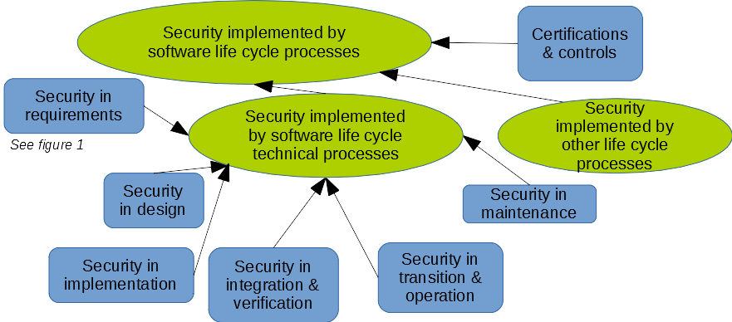
Assurance case: Next level (partial figure 2)
…
Not a waterfall-
These are processes, not phases

Slide 37
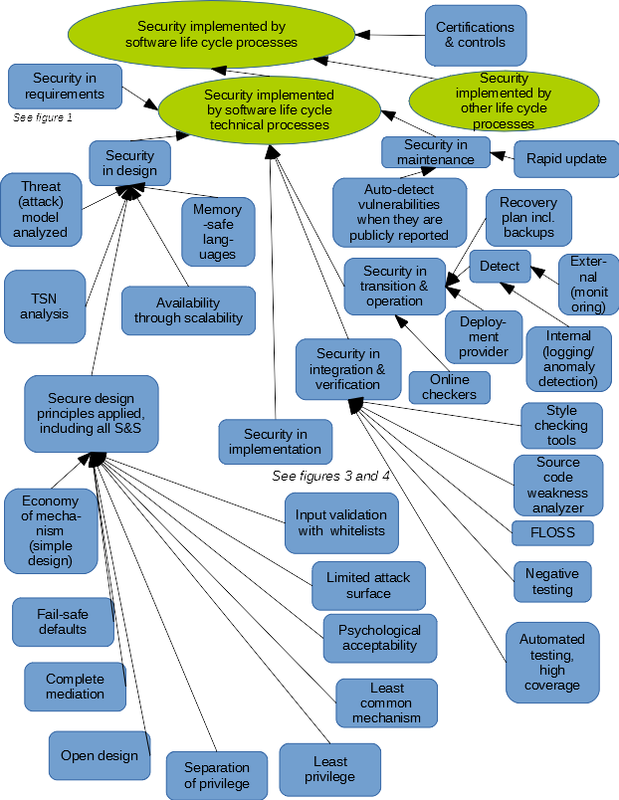
Life cycle technical processes (figure 2)
Design: Esp. attack model + Saltzer & Schr-oeder principles
Verification: many tools

Slide 38
Security in implementation (figure 3)
Reuse/
Supply chain
OWASP Top 10
Web hardening, esp. CSP

Slide 39
BadgeApp dependencies and security
Tiny amount of new code in our system…
Because almost all code is reused
Direct dependencies = 75 gems
Direct AND indirect dependencies = 197 gems
Plus OS, language runtime, RDBMS, etc.
Today a key security concern for most projects is vulnerabilities through their dependencies
Minimize dependencies, ask them to minimize their run-time dependencies, sanity check of direct dependencies
Package manager: Track what we have, trivially update packages
Dependency tools*: detect & report packages with known vulnerabilities (GitHub + bundle audit)
Thorough automated tests: enable quick update, test, & ship to production (we have 100% coverage)
Other measures, esp. hardening (such as CSP), reduce risk in meantime
* Origin analysis / software composition analysis tools
Notes:
Physical LOC: Code 3,181; Test 2,831
https://codeclimate.com/blog/deciphering-ruby-code-metrics/

Slide 40
Got on Hacker News (HN)!
Badge-related post got on Hacker News front page on 2018-10-06
“Certainly not knocking on the badge or the practices…I just found it amusing that PHP often gets a bad rap, but then shows up at the top of the listed projects for objectively good development practices.” - reindeerer
“I just found and read through the criteria list. It's mind-bogglingly exhaustive, but in a very good way, and an excellent catalyst for maintainable, secure software. I'd regard it as universally applicable to any and all code.” – exikyut
“Lots of self-proclaimed ‘experts’ love to say ‘do X and Y and Z and you will be successful because these are best practices’, but it's all a bunch of snake oil… ‘Best practices are best not practiced.’” – userbinator, dissenting, but then downvoted & replied to…
“Best practices are a bit like good genes. [They’re] by no means a guarantee of success, fame, glory and riches, but damn if they don't make things easier.” - reindeerer
“I see absolutely nothing dogmatic or cargo cult about the recommendations they make. They are completely sensible, and a decent guideline for improving the technical support infrastructure of a project.” - throwaway2048
Source: https://news.ycombinator.com/item?id=18157494

Slide 41

Natural languages supported
English (en)
Chinese (Simplified) / 简体中文 (zh-CN)
French / Français (fr)
German / Deutsch (de)
Japanese / 日本語 (ja)
Russian / Русский (ru)
In progress:
Spanish (es), Swahili (sw), Brazilian Portuguese (pt-BR)
Our sincere thanks to all our hard-working translators!!
Help wanted!
Even if you can’t understand the detailed justifications, you can see the criteria & claimed answers

Slide 42
Open source software
OSS: software licensed to users with these freedoms:
to run the program for any purpose,
to study and modify the program, and
to freely redistribute copies of either the original or modified program (without royalties to original author, etc.)
Original term: “Free software” (confused with no-price)
Other synonyms: libre sw, free-libre sw, FOSS, FLOSS
Antonyms: proprietary software, closed software
Widely used; OSS #1 or #2 in many markets
“… plays a more critical role in the DoD than has generally been recognized.” [MITRE 2003]
OSS almost always commercial by law & regulation
Software licensed to general public & has non-government use → commercial software (in US law, per 41 USC 403)

Slide 43
Statistics about the criteria themselves
Level | Total active | MUST | SHOULD | SUGG-ESTED | Allow N/A | Met justifi-cation or URL required | Includes details | New at this level
Passing | 66 | 42 | 10 | 14 | 27 | 9 | 48 | 66
Silver | 55 | 44 | 10 | 1 | 39 | 54 | 38 | 48
Gold | 23 | 21 | 2 | 0 | 9 | 21 | 15 | 14
There are not a lot of gold criteria, but they’re challenging.
Source: https://bestpractices.coreinfrastructure.org/criteria
as of 2017-09-10

Slide 44
Passing criteria categories and examples (1)
Basics
The software MUST be released as FLOSS*. [floss_license]
It is SUGGESTED that any required license(s) be approved by the Open Source Initiative (OSI). [floss_license_osi]
2. Change Control
The project MUST have a version-controlled source repository that is publicly readable and has a URL. [repo_public]
Details: The URL MAY be the same as the project URL. The project MAY use private (non-public) branches in specific cases while the change is not publicly released (e.g., for fixing a vulnerability before it is revealed to the public).
3. Reporting
The project MUST publish the process for reporting vulnerabilities on the project site. [vulnerability_report_process]
*FLOSS=Free/Libre/Open Source Software

Slide 45
Passing criteria categories and examples (2)
4. Quality
If the software requires building for use, the project MUST provide a working build system that can automatically rebuild the software from source code. [build]
The project MUST have at least one automated test suite that is publicly released as FLOSS (this test suite may be maintained as a separate FLOSS project). [test]
The project MUST have a general policy (formal or not) that as major new functionality is added, tests of that functionality SHOULD be added to an automated test suite. [test_policy]
The project MUST enable one or more compiler warning flags, a "safe" language mode, or use a separate "linter" tool to look for code quality errors or common simple mistakes, if there is at least one FLOSS tool that can implement this criterion in the selected language. [warnings]

Slide 46
Passing criteria categories and examples (3)
5. Security
At least one of the primary developers MUST know of common kinds of errors that lead to vulnerabilities in this kind of software, as well as at least one method to counter or mitigate each of them. [know_common_errors]
The project's cryptographic software MUST use only cryptographic protocols and algorithms that are publicly published and reviewed by experts. [crypto_published]
The project MUST use a delivery mechanism that counters MITM attacks. Using https or ssh+scp is acceptable. [delivery_mitm]
There MUST be no unpatched vulnerabilities of medium or high severity that have been publicly known for more than 60 days. [vulnerabilities_fixed_60_days]

Slide 47
Passing criteria categories and examples (4)
6. Analysis
At least one static code analysis tool MUST be applied to any proposed major production release of the software before its release, if there is at least one FLOSS tool that implements this criterion in the selected language… [static_analysis]
It is SUGGESTED that the {static code analysis} tool include rules or approaches to look for common vulnerabilities in the analyzed language or environment. [static_analysis_common_vulnerabilities]
It is SUGGESTED that at least one dynamic analysis tool be applied to any proposed major production release of the software before its release. [dynamic_analysis]

Slide 48
Silver: Sample criteria (1 of 2)
The project MUST clearly define and document its project governance model (the way it makes decisions, including key roles). [governance]
The project MUST be able to continue with minimal interruption if any one person is incapacitated or killed… [you] MAY do this by providing keys in a lockbox and a will providing any needed legal rights (e.g., for DNS names). [access_continuity]
The project MUST have FLOSS automated test suite(s) that provide at least 80% statement coverage if there is at least one FLOSS tool that can measure this criterion in the selected language. [test_statement_coverage80]
The project MUST automatically enforce its selected coding style(s) if there is at least one FLOSS tool that can do so in the selected language(s). [coding_standards_enforced]
The project MUST implement secure design principles (from "know_secure_design"), where applicable… [implement_secure_design]

Slide 49
Silver: Sample criteria (2 of 2)
The project results MUST check all inputs from potentially untrusted sources to ensure they are valid (a whitelist), and reject invalid inputs, if there are any restrictions on the data at all. [input_validation]
The project MUST cryptographically sign releases of the project results intended for widespread use, and there MUST be a documented process explaining [how to] obtain the public signing keys and verify the signature(s)… [signed_releases]
The project MUST provide an assurance case that justifies why its security requirements are met. [It MUST…] [assurance_case]
The project MUST use at least one static analysis tool … to look for common vulnerabilities… , if there is at least one FLOSS tool that can… [static_analysis_common_vulnerabilities]
Projects MUST monitor or periodically check their external dependencies (including convenience copies) to detect known vulnerabilities, and fix exploitable vulnerabilities or verify them as unexploitable. [dependency_monitoring]

Slide 50
Gold: Sample criteria
The project MUST require two-factor authentication (2FA) for developers for changing a central repository or accessing sensitive data (such as private vulnerability reports)… [require_2FA]
The project MUST have at least 50% of all proposed modifications reviewed before release by a person other than the author… [two_person_review]
The project MUST have a "bus factor" of 2 or more. [bus_factor]
The project MUST have a reproducible build… [build_reproducible]
The project MUST apply at least one dynamic analysis tool to any proposed major production release of the software before its release. [dynamic_analysis]
The project MUST have performed a security review within the last 5 years. This review MUST consider the security requirements and security boundary. [security_review]
Hardening mechanisms MUST be used in the software produced by the project so that software defects are less likely to result in security vulnerabilities. [hardening]

Slide 51
Key URLs
CII best practices badge (get a badge):
https://bestpractices.coreinfrastructure.org/
CII best practices badge project:
https://github.com/coreinfrastructure/best-practices-badge
My thanks to the many who reviewed or helped develop the badging criteria and/or the software to implement it. This includes: Mark Atwood, Tod Beardsley, Doug Birdwell, Alton(ius) Blom, Hanno Böck, enos-dandrea, Jason Dossett, David Drysdale, Karl Fogel, Alex Jordan (strugee), Sam Khakimov, Greg Kroah-Hartman, Dan Kohn, Charles Neill (cneill), Mark Rader, Emily Ratliff, Tom Ritter, Nicko van Someren, Daniel Stenberg (curl), Marcus Streets, Trevor Vaughan, Dale Visser, Florian Weimer

Slide 52
Involved in OSS?
If you lead an OSS project, what you do matters!
People depend on the software you create
The practices you apply affect the result
Secure or quality software is not an accident
Please try to get a badge, & show when you have it
If you’re considering using an OSS project
Check on the project – should you use it?

Slide 53
Release of presentation
This presentation is released under Creative Commons Attribution 3.0 or later (CC-BY-3.0+)
Credits
Older versions were developed by the Institute for Defense Analyses (IDA); thank you!

